Slide 1
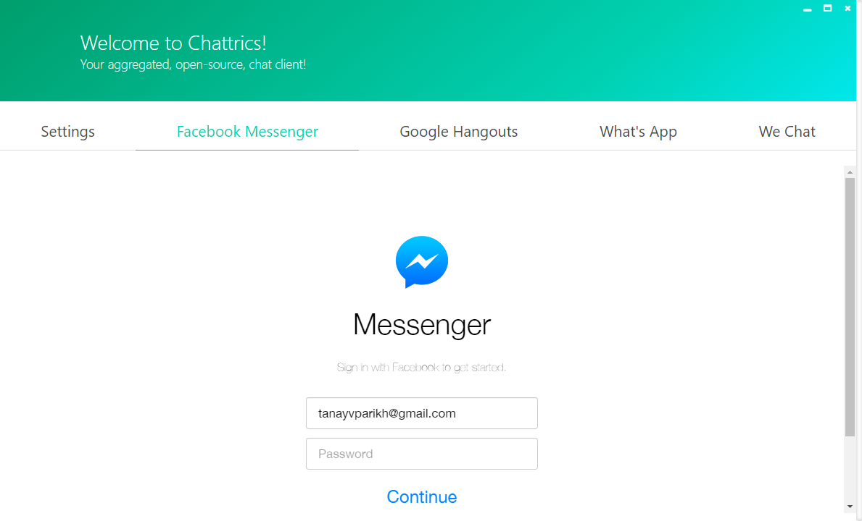

ChattriCS

Slide 2
A WORLD OF CHAT

Slide 3



WHAT IT DOES
Facebook Messenger
CHATTRICS
Google Hangouts
Whats App

Slide 4






WeChat
Skype
Slack
Discord
Telegram
Steam

Slide 5
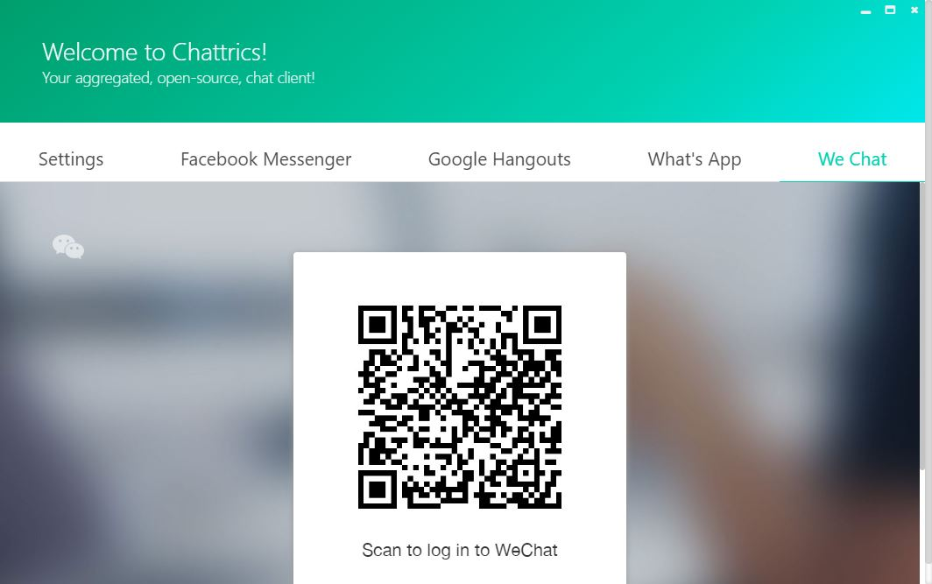
Multiple Authentication Methods
CHATTRICS
Password
Facebook Messenger, Google Hangouts
QR Codes
WhatsApp, WeChat

Slide 6
MODERN DESIGN
Keep it simple.

Slide 7
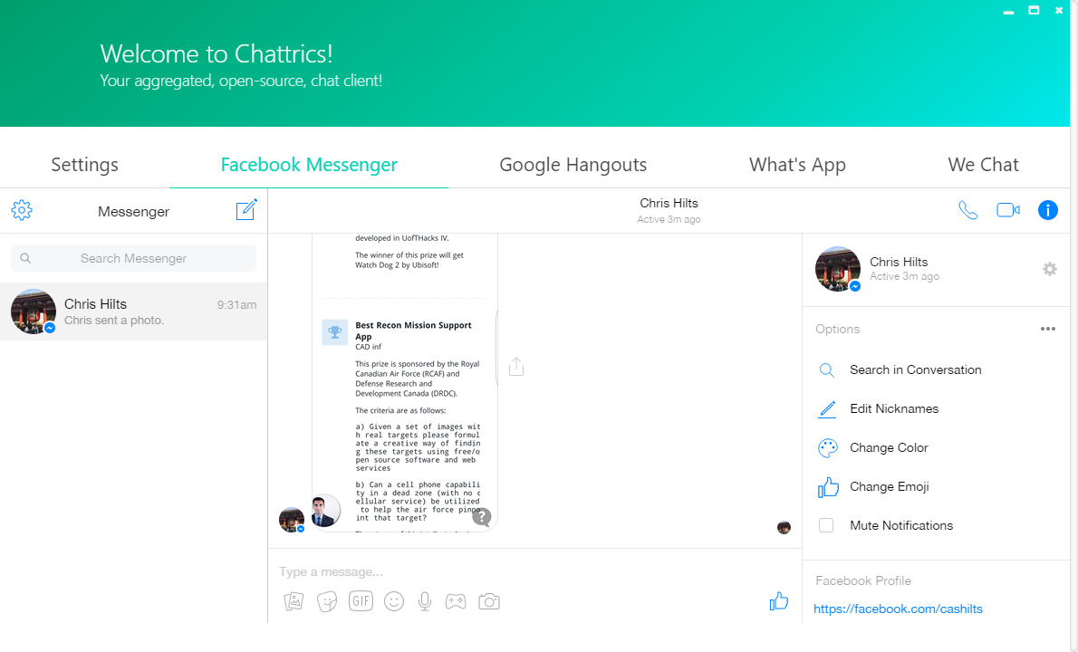
MODERN DESIGN
Keep it simple.

Slide 8



OUR STACK
CHATTRICS
ELECTRON
VUE.JS
BULMA
DESKTOP CLIENT
JS FRAMEWORK
CSS FRAMEWORK

Slide 9


CASE STUDIES
SUPRIMO TEMPLATE
THE FUTURE OF CHATTRICS
CHART.JS
Dynamic Chat Metrics

Slide 10
The Roadmap
CHATTRICS
25+
15
1K
SERVICES
METRICS
INSTALLS

Slide 11
THANK YOU

